Slide 1

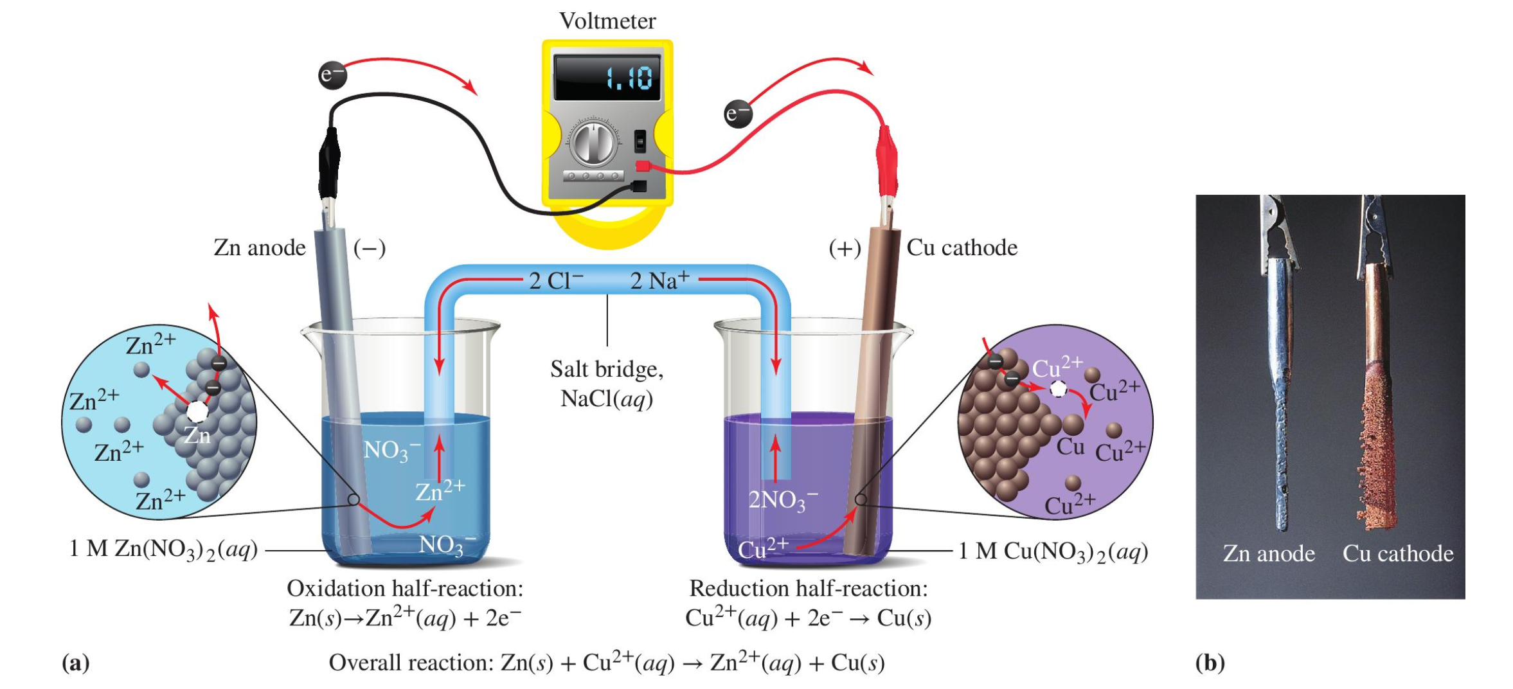
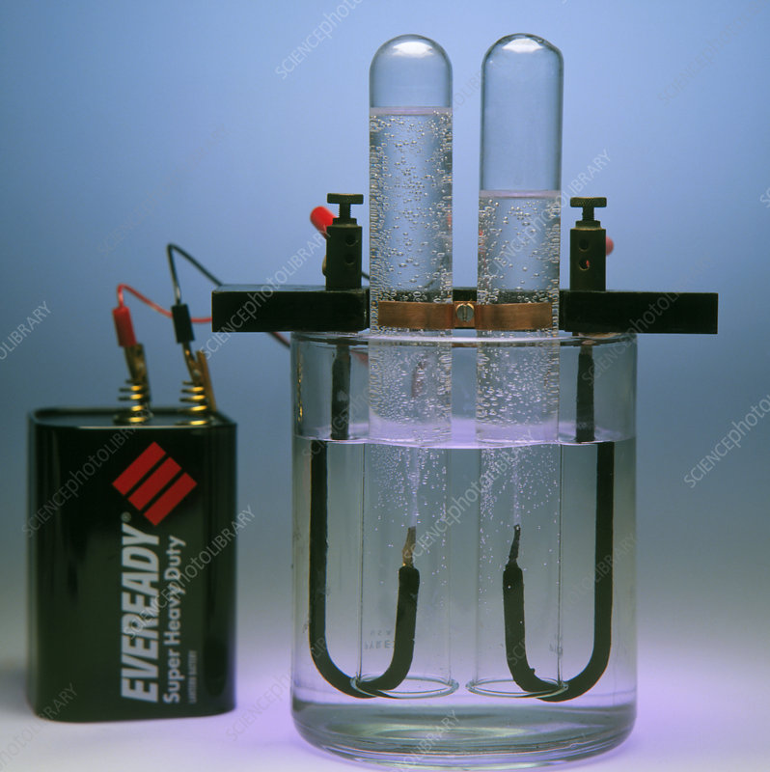
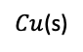
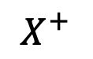
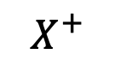
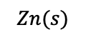
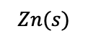
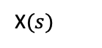
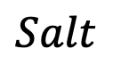
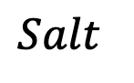
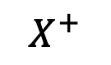

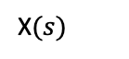
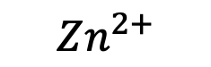
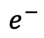
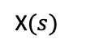
Lab this week …
Part 1. Built some Galvanic Cells
A Daniell cell, measure its voltage, figure out which is the cathode
A Galvanic cell with unknown “X”, use the voltage to identify the unknown
A concentration cell and figure out which side has the higher concentration
Part 2. Look at an electrolysis apparatus
$$Salt$$
$$Zn^{2+}$$
$${Cu}^{2+}$$
$$Zn(s)$$
$Cu$(s)
$$Salt$$
$$e^{−}$$
$$Zn^{2+}$$
$$X^{+}$$
$$Zn(s)$$
X$(s)$
$$e^{−}$$
$$Salt$$
$$X^{+}$$
$$X^{+}$$
X$(s)$
X$(s)$
$$e^{−}$$

Slide 2
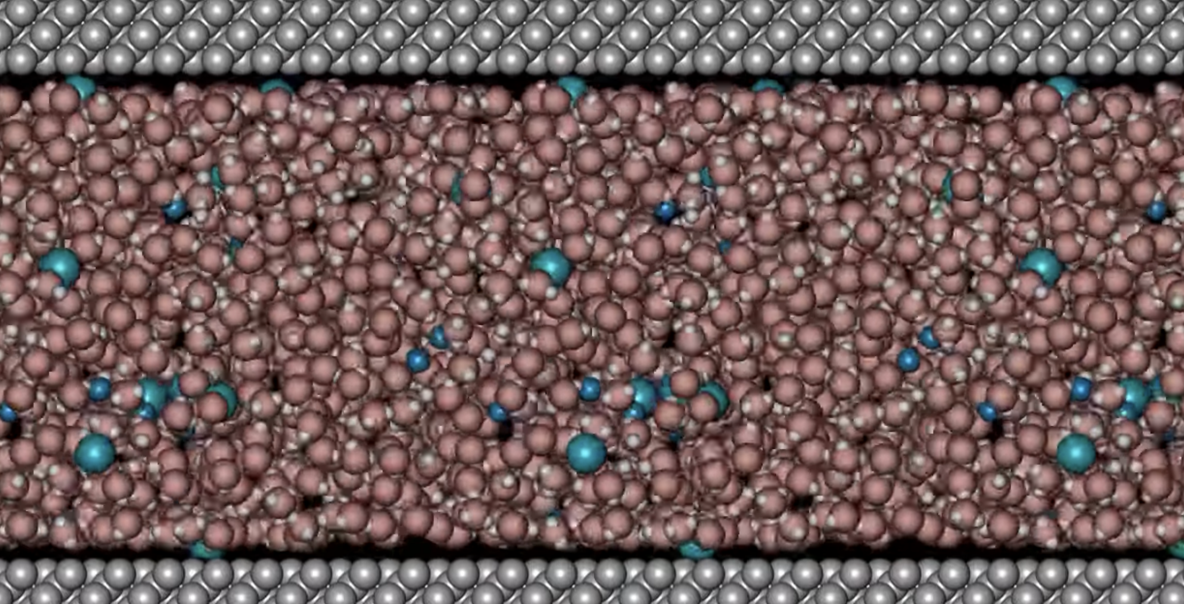
Recap: Solutions, solvents, and solutes
https://youtu.be/Khg9ozS8A6U
In this solution (mixture), water is the solvent, the other things (cations and anions) are solutes.
Generally, there’s a lot more of the solvent.

Slide 3
Recap: Molarity as a measure of concentration
https://youtu.be/Khg9ozS8A6U
Chemists measure the concentration of solute using a unit called molarity: it’s the # of moles of the solute in each Liter of solution.
The symbol for molarity is “M”
In the bracket notation for molarity, “[X]” means “concentration of solute X”

Slide 4
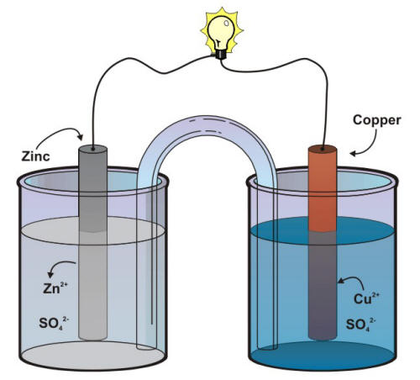

Recap: half-reactions and spontaneous overall reactions
anode
cathode
Zinc releases (loses) electrons
Copper consumes (gains) electrons
Overall reaction indicating the direction of spontaneous change:
$$Cu^{2+}+Zn →Cu+Zn^{2+}$$

Slide 5
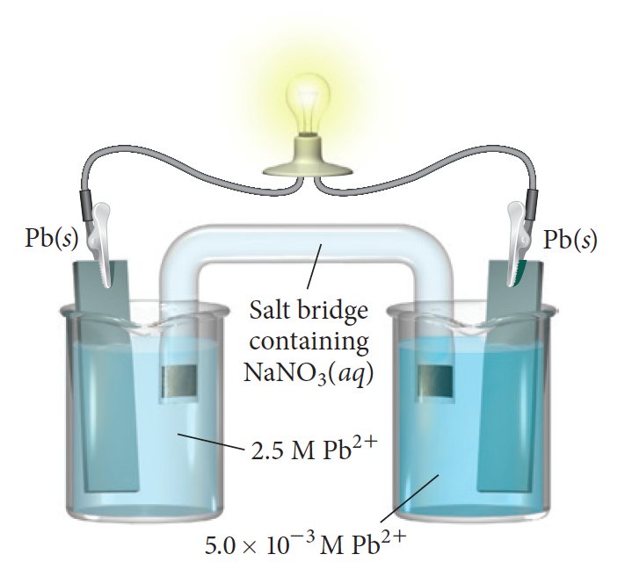
Recap: When we have different cation concentrations
Black
>0
Red
Zn(s)
[Pb²⁺] = 0.1 M
[Pb²⁺] = 1 M
Pb²⁺
Pb²⁺
https://web.mst.edu/~gbert/Electro/Electrochem.html

Slide 6
That link also works for different concentrations and different cations!
Black
-0.565
Red
Zn(s)
[Pb²⁺] = 0.01 M
[Zn²⁺] = 2 M
Pb²⁺
Zn²⁺
https://web.mst.edu/~gbert/Electro/Electrochem.html

Slide 7
Charging vs discharging
Black
-0.565
Red
Zn(s)
[Pb²⁺] = 0.01 M
[Zn²⁺] = 2 M
Pb²⁺
Zn²⁺
This cell is discharging (i.e., acting as an energy source)

Slide 8
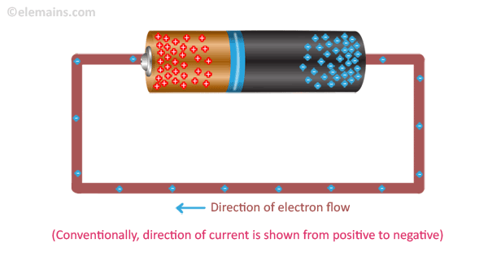
Charging vs discharging
V > 0.565
+
-
Zn(s)
[Pb²⁺] = 0.01 M
[Zn²⁺] = 2 M
Pb²⁺
Zn²⁺
This cell is charging (i.e., storing energy)
Requires an overvoltage

Slide 9
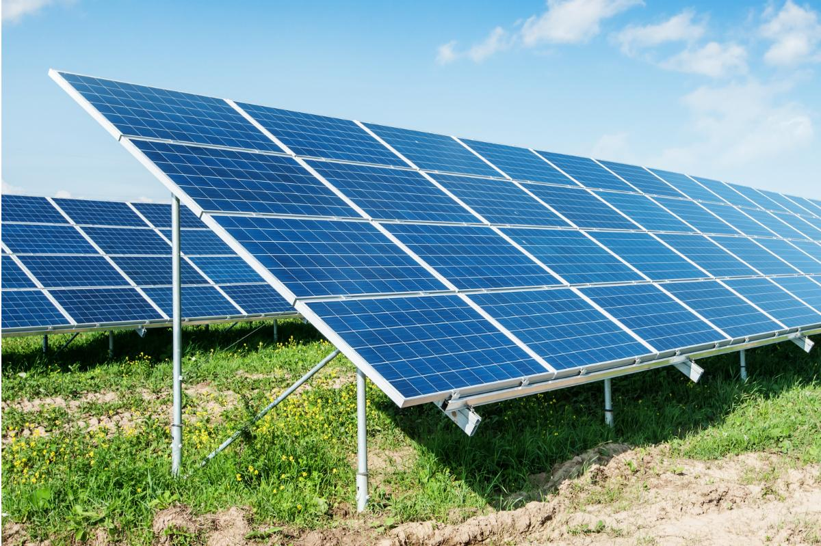
Charging vs discharging
V > 0.565
+
-
Zn(s)
[Pb²⁺] = 0.01 M
[Zn²⁺] = 2 M
Pb²⁺
Zn²⁺
This cell is charging (i.e., storing energy)
Requires an overvoltage

Slide 10
Other ideas for batteries … Lithium ion
Lithium ion batteries are cool because they’re
Really light (because Lithium is really light)
Rechargeable lots of times

Slide 11
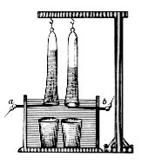

H₂ is a fuel that you can make from water!
Johann Wilhelm Ritter
~1800

Slide 12
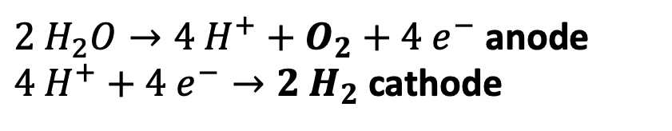
Can you tell which side is the anode and which is the cathode?
$2 H_{2}O→4{ H}^{+}+O_{2}+4 e^{−}$ anode
$4{ H}^{+}+4 e^{−}→2 H_{2}$ cathode
Hint: Look at the volumes of gases being produced.

Slide 13
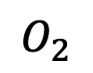
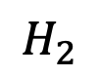
Can you tell which side is the anode and which is the cathode?
$$O_{2}$$
$$H_{2}$$
$2 H_{2}O→4{ H}^{+}+O_{2}+4 e^{−}$ anode
$4{ H}^{+}+4 e^{−}→2 H_{2}$ cathode
Hint: Look at the volumes of gases being produced.

Slide 14
Can you tell which side is the anode and which is the cathode?
$$O_{2}$$
$$H_{2}$$
$2 H_{2}O→4{ H}^{+}+O_{2}+4 e^{−}$ anode
$4{ H}^{+}+4 e^{−}→2 H_{2}$ cathode
Of course, an overvoltage is required (here it’s a 6 V battery, evidently that’s enough)
anode
cathode

Slide 15
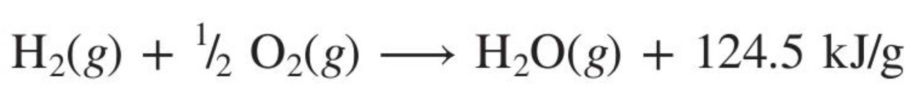
Can you spot two comparative advantages of H₂ as a fuel?

Slide 16
Can you spot two comparative advantages of H₂ as a fuel?
Water is the only product (no CO₂!)

Slide 17
Can you spot two comparative advantages of H₂ as a fuel?
Water is the only product – no CO₂!
The energy density is huge – even compared to hydrocarbons!

Slide 18
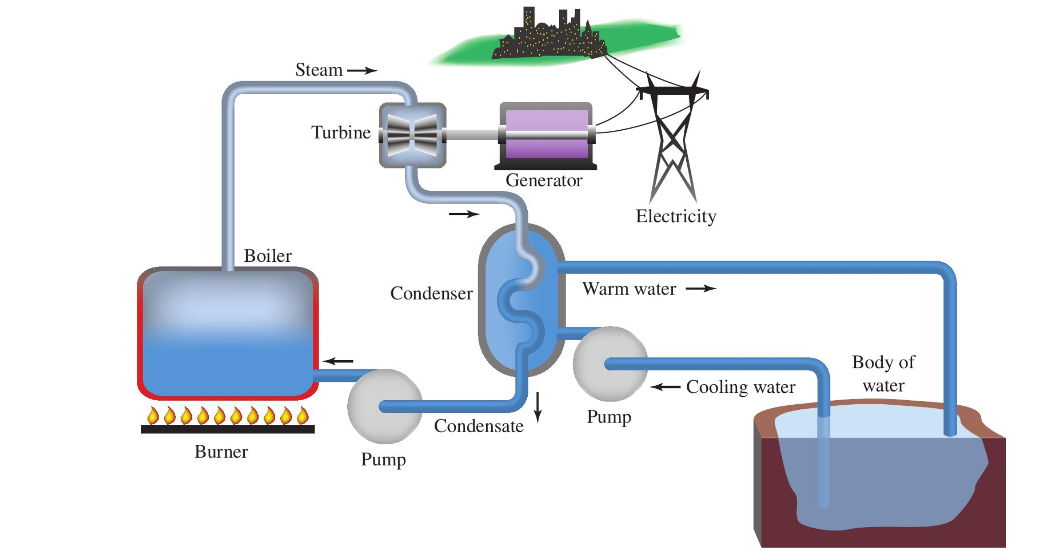
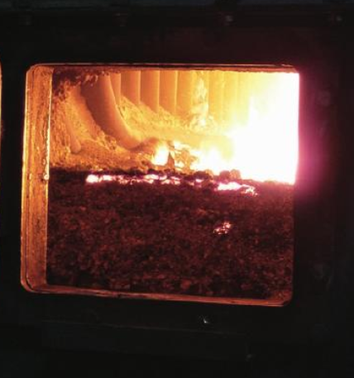
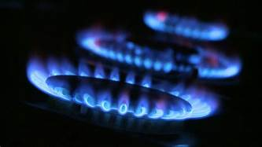

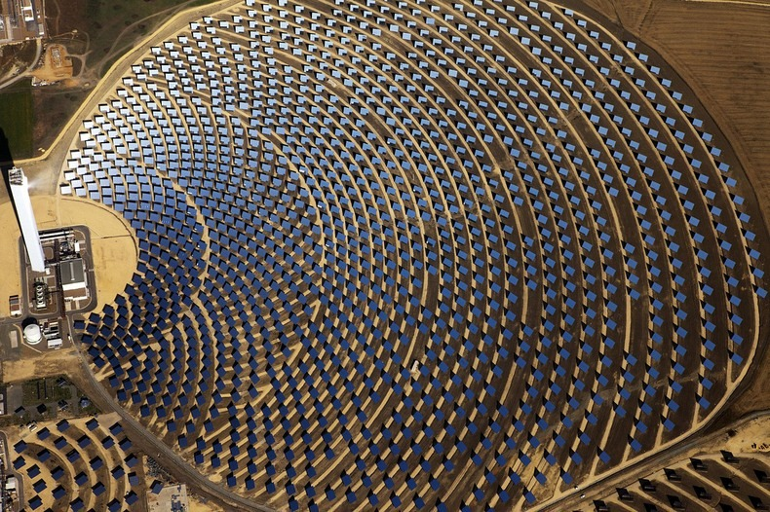
Burning H₂ in a conventional power plant is one possibility …
Coal/oil/gas
H₂
Nuclear fission
Solar energy

Slide 19
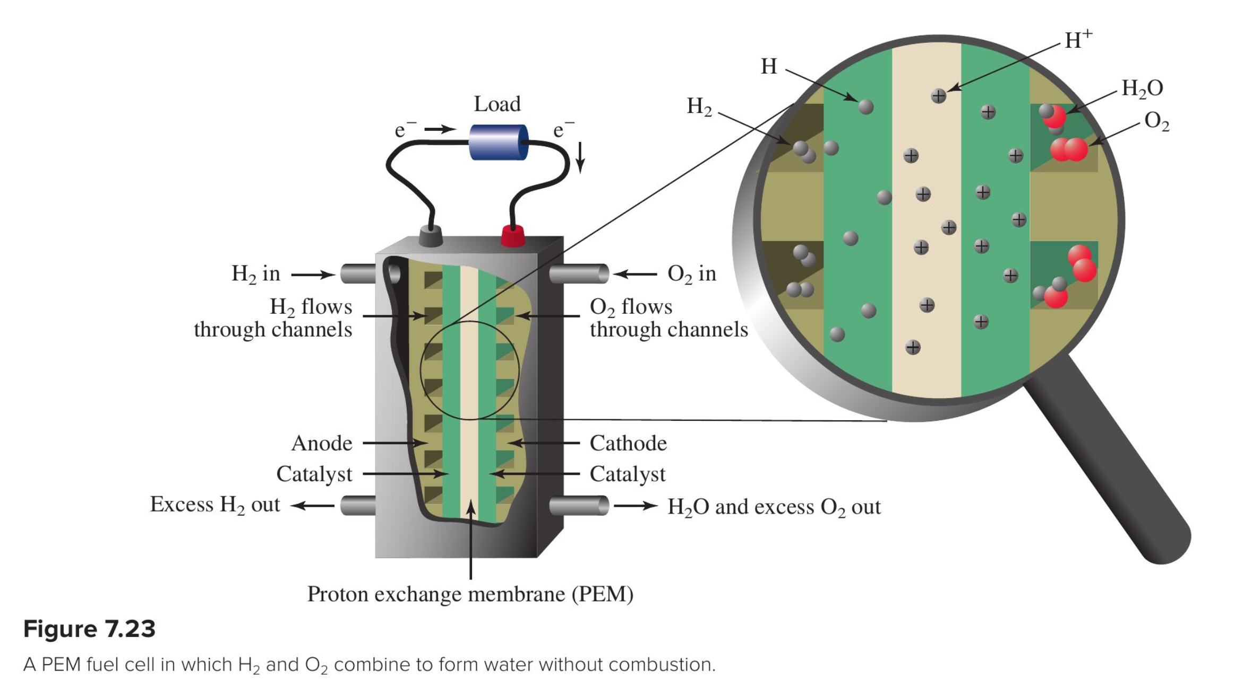
But fuel cells are more efficient

Slide 20
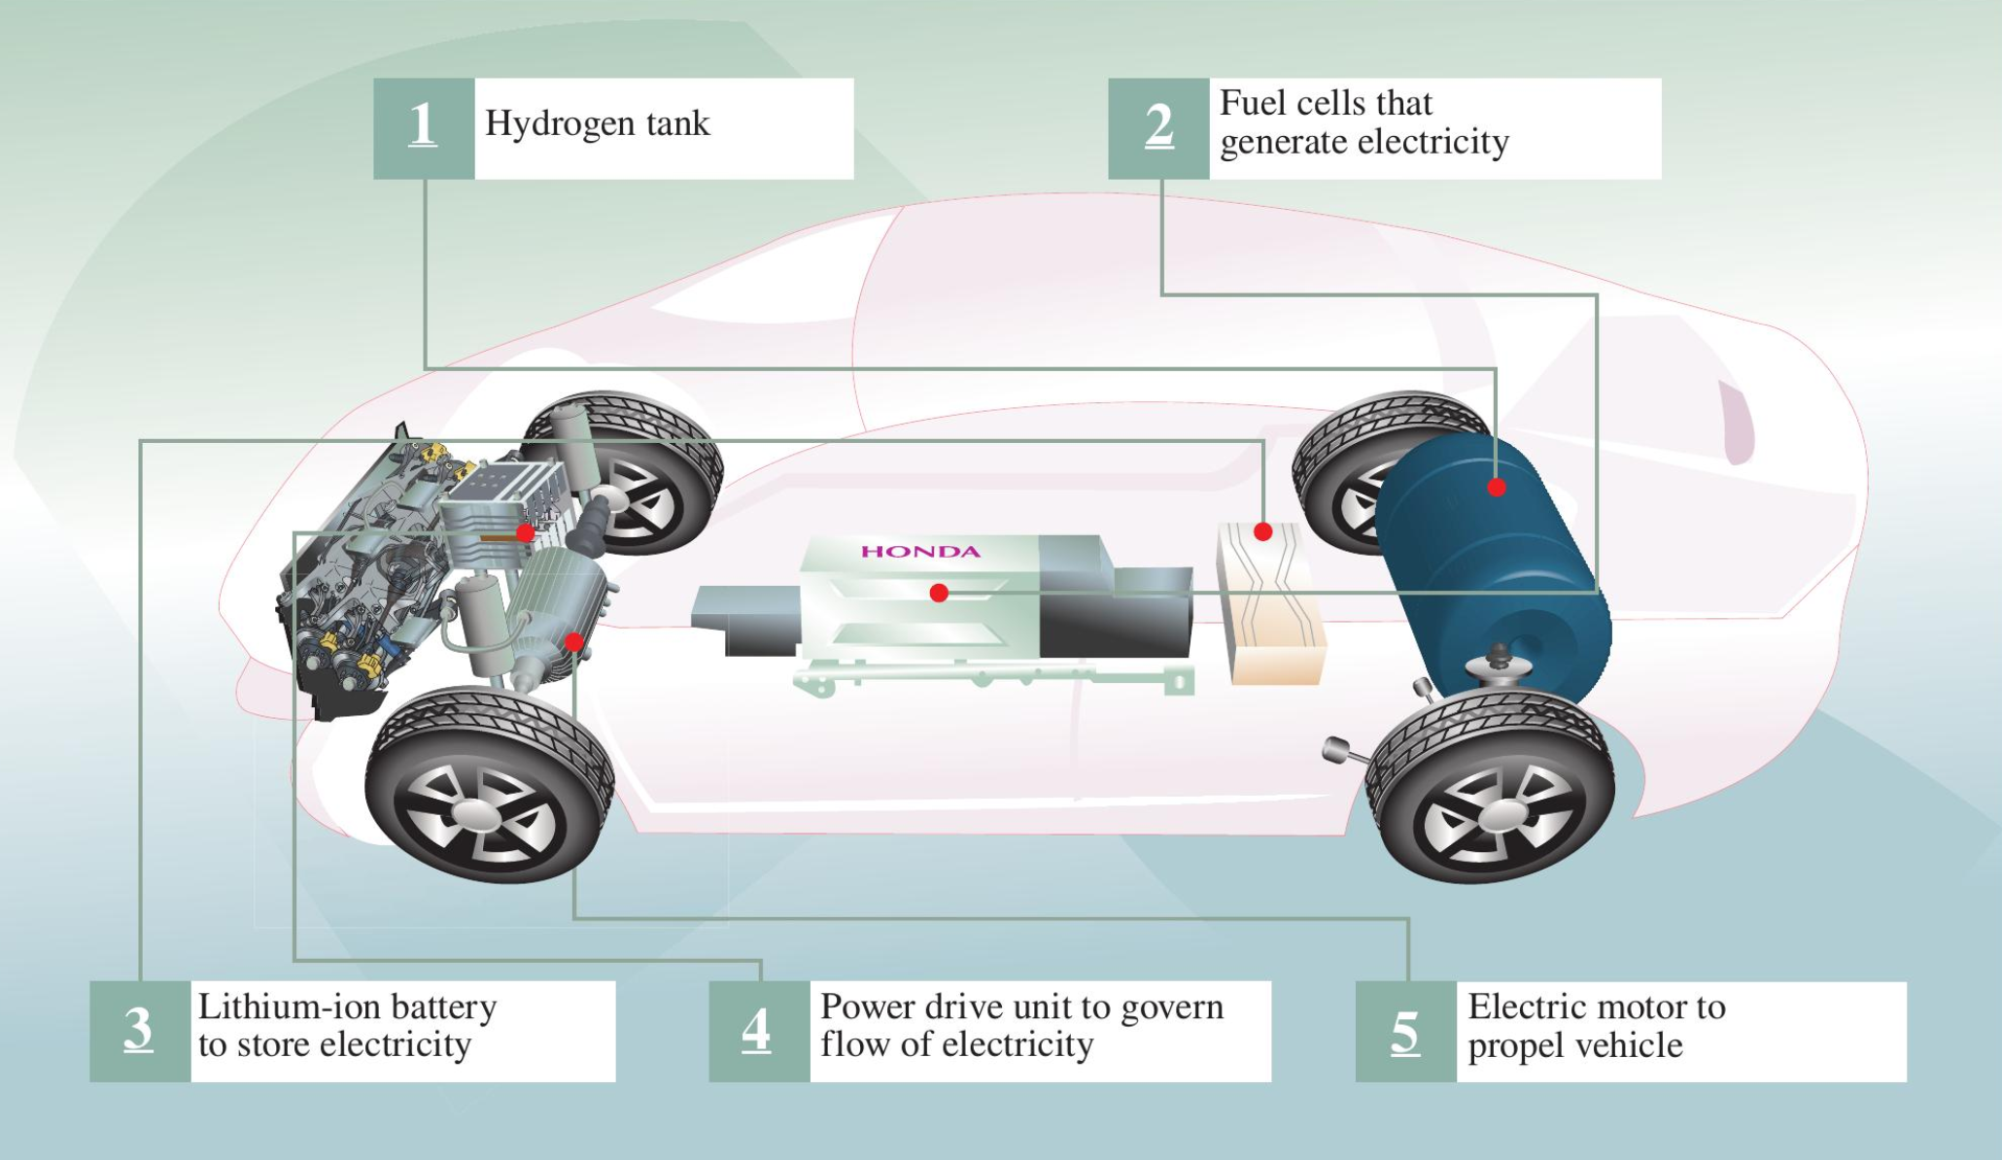
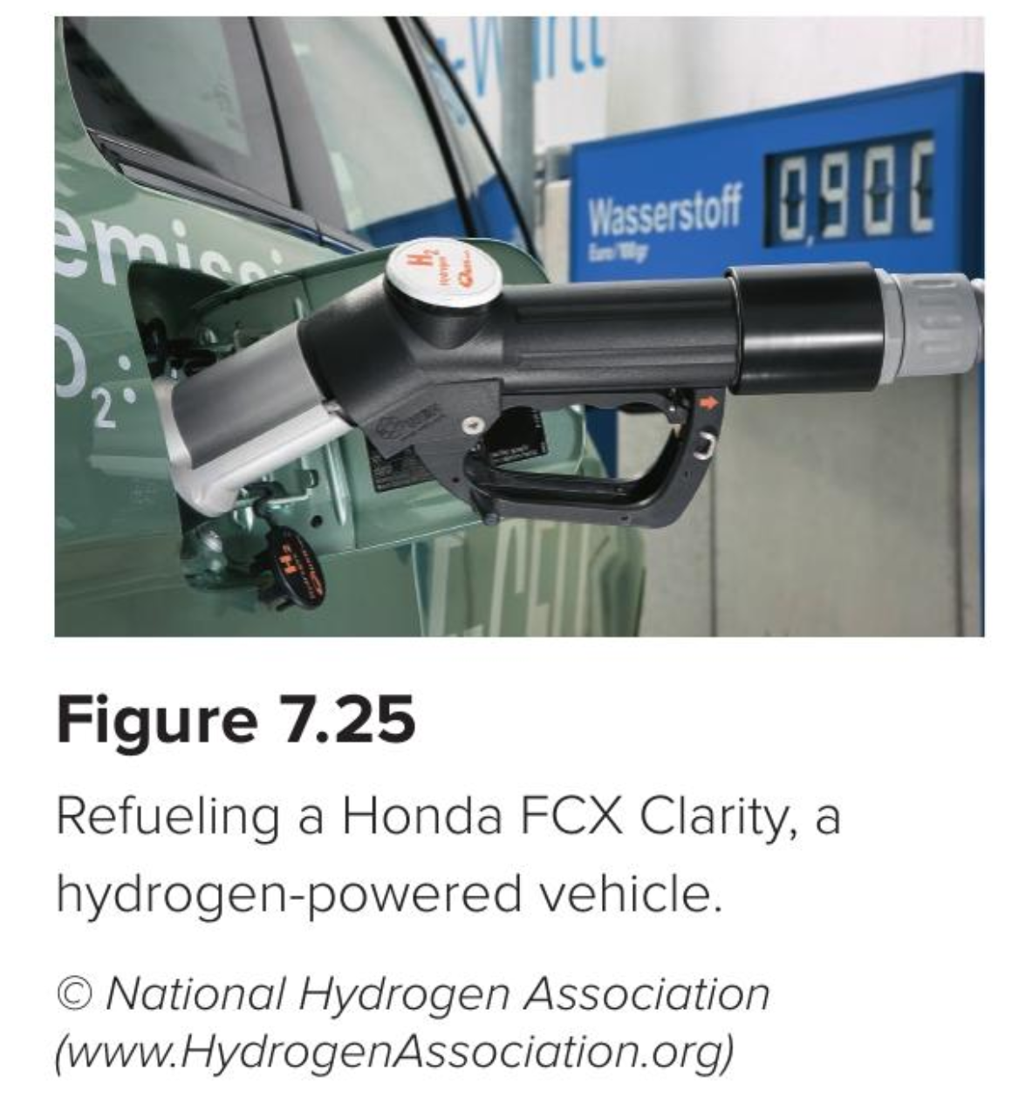
Hydrogen fuel cells coupled with a Li-ion battery could be pretty awesome

Slide 21
Sustainability of the solution
Hou et al’s alloys contain Mg, La, and Ni … Is that sustainable?
From the American Chemical Society, 2015, “Periodic Table of Endangered Elements”

Slide 22
Sustainability of the solution
Hou et al’s alloys contain Mg, La, and Ni … Is that sustainable?
From the American Chemical Society, 2015, “Periodic Table of Endangered Elements”

